Slide 1

Residential Location Choice for Workers in the Era of Shared Autonomous Vehicles
Wenwen Zhang, Subhrajit Guhathakurta
Nov. 4th, 2016
2016 ACSP Conference | Portland, OR

Slide 2

Autonomous Vehicles & Sharing Economy
There is “NATURAL MUTUALISM” between vehicle automation technology and car-sharing and ride-sharing program
Shared Autonomous Vehicles
[SAV]
Ubiquitous transit system
Affordable
Reliable
Efficient
Environmental Friendly
ON
DEMAND

Slide 3
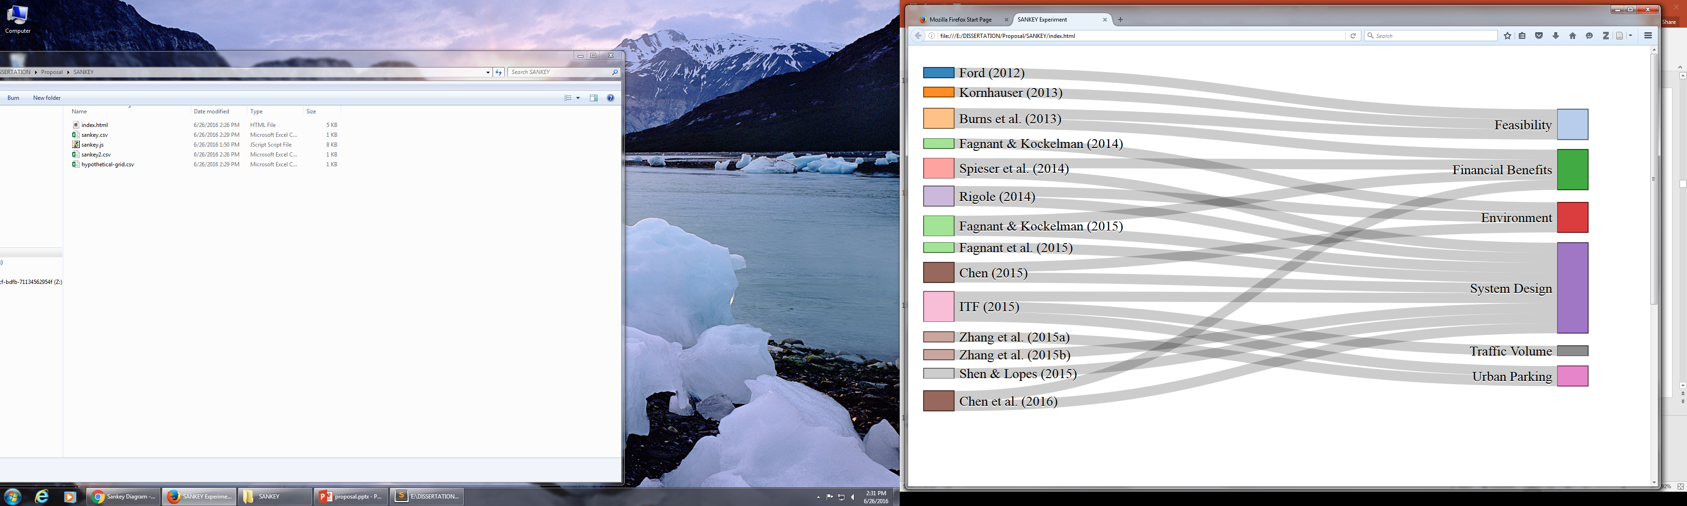
Existing SAV Modeling Efforts
Studies [total=14]
Objectives
Feasibility
Other Impacts
Urban Form

Slide 4
How about Urban Land Use?
Disruptive transportation technology undoubtedly lead to urban land use changes
Source: Giuliano, G. (1995) "Land Use Impacts of Transportation Investments: Highway and Transit", in S. Hanson (ed) The Geography of Urban Transportation, New York: The Guilford Press
“Town planners, property developers and builders need to start thinking about the effect of self-driving technology on demand for roads, parking, housing and so on. So far there is little sign that this is happening” -- Economist (2012)

Slide 5
Research Questions
How will an SAV system influence RESIDENTIAL LOCATION CHOICES for workers, in the Atlanta Metropolitan Area?

Slide 6
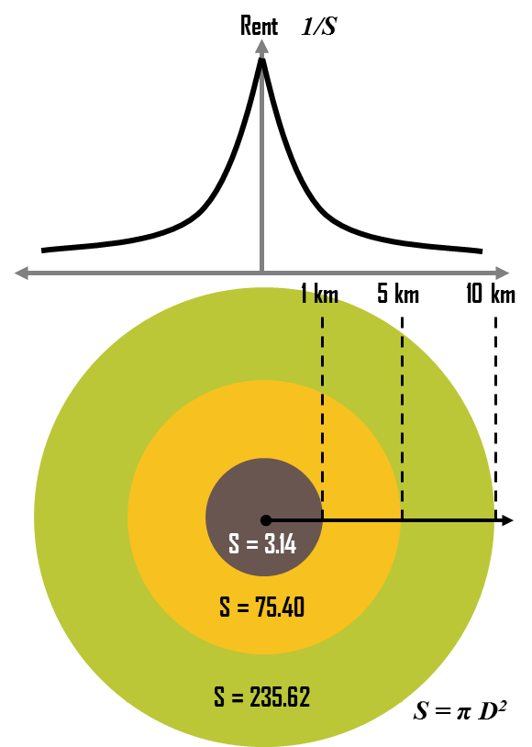


SAVs and Residential Location Choice
s
Accessibility Factors
Travel costs (von Thünen, 1826; Alonso, 1964)
Commute time
Private Car (Guo & Bhat, 2007; Habib & Miller, 2009; Lee, Waddell, Wang, & Pendyala, 2010)
Transit (Pinjari, Bhat, & Hensher, 2009; Pinjari, Pendyala, Bhat, & Waddell, 2011)
The accessibility of SAVs vary throughout the city
Easiness to find ride-sharing
Distribution of SAVs in the city
How will SAVs change the commute travel costs, especially the time and operation costs?
How will such change influence people’s residential location choice?
Source: https://people.hofstra.edu/geotrans/eng/ch6en/conc6en/landrenttheory.html

Slide 7
Research Framework
1
Residential Location Choice Model
2
Discrete Event SAV Simulation
3
Update Residential location choice model
Atlanta Travel Survey + Zillow Property Records
The role of transportation cost in residential location choice
Multinominal Logit Model by market segments
Age
Lifecycle
Simulate the performance of SAV system when fulfilling the travel demand of residents in 10 county Atlanta Area
Updating transportation costs in the era of SAVs
Update the transportation costs variables
Recalculate the probability distribution among alternatives
Observe how household’s preference may shift due to the introduction of SAVs
Notes:
Replace the methodology

Slide 8

Residential Location Choice Model Data Sources
1
Atlanta Travel Survey
Zillow Property Records
$380,000
$350,000
$240,000
Home Address
Sept
2013
Nov 2010
Mar
2009
Jun
2006
Time
Nov 2010 – Jan 2011
* The household lived here
* The household purchased the unit
Size
Income
Race/Ethnic Group
Lifecycle
Age
Vehicle Ownership
Work Places
Bedroom
Bathroom
Finished SQFT
Lot Size
School District
Year Built
Households who purchased the unit within 5 years from the travel survey time are included in the final model.

Slide 9
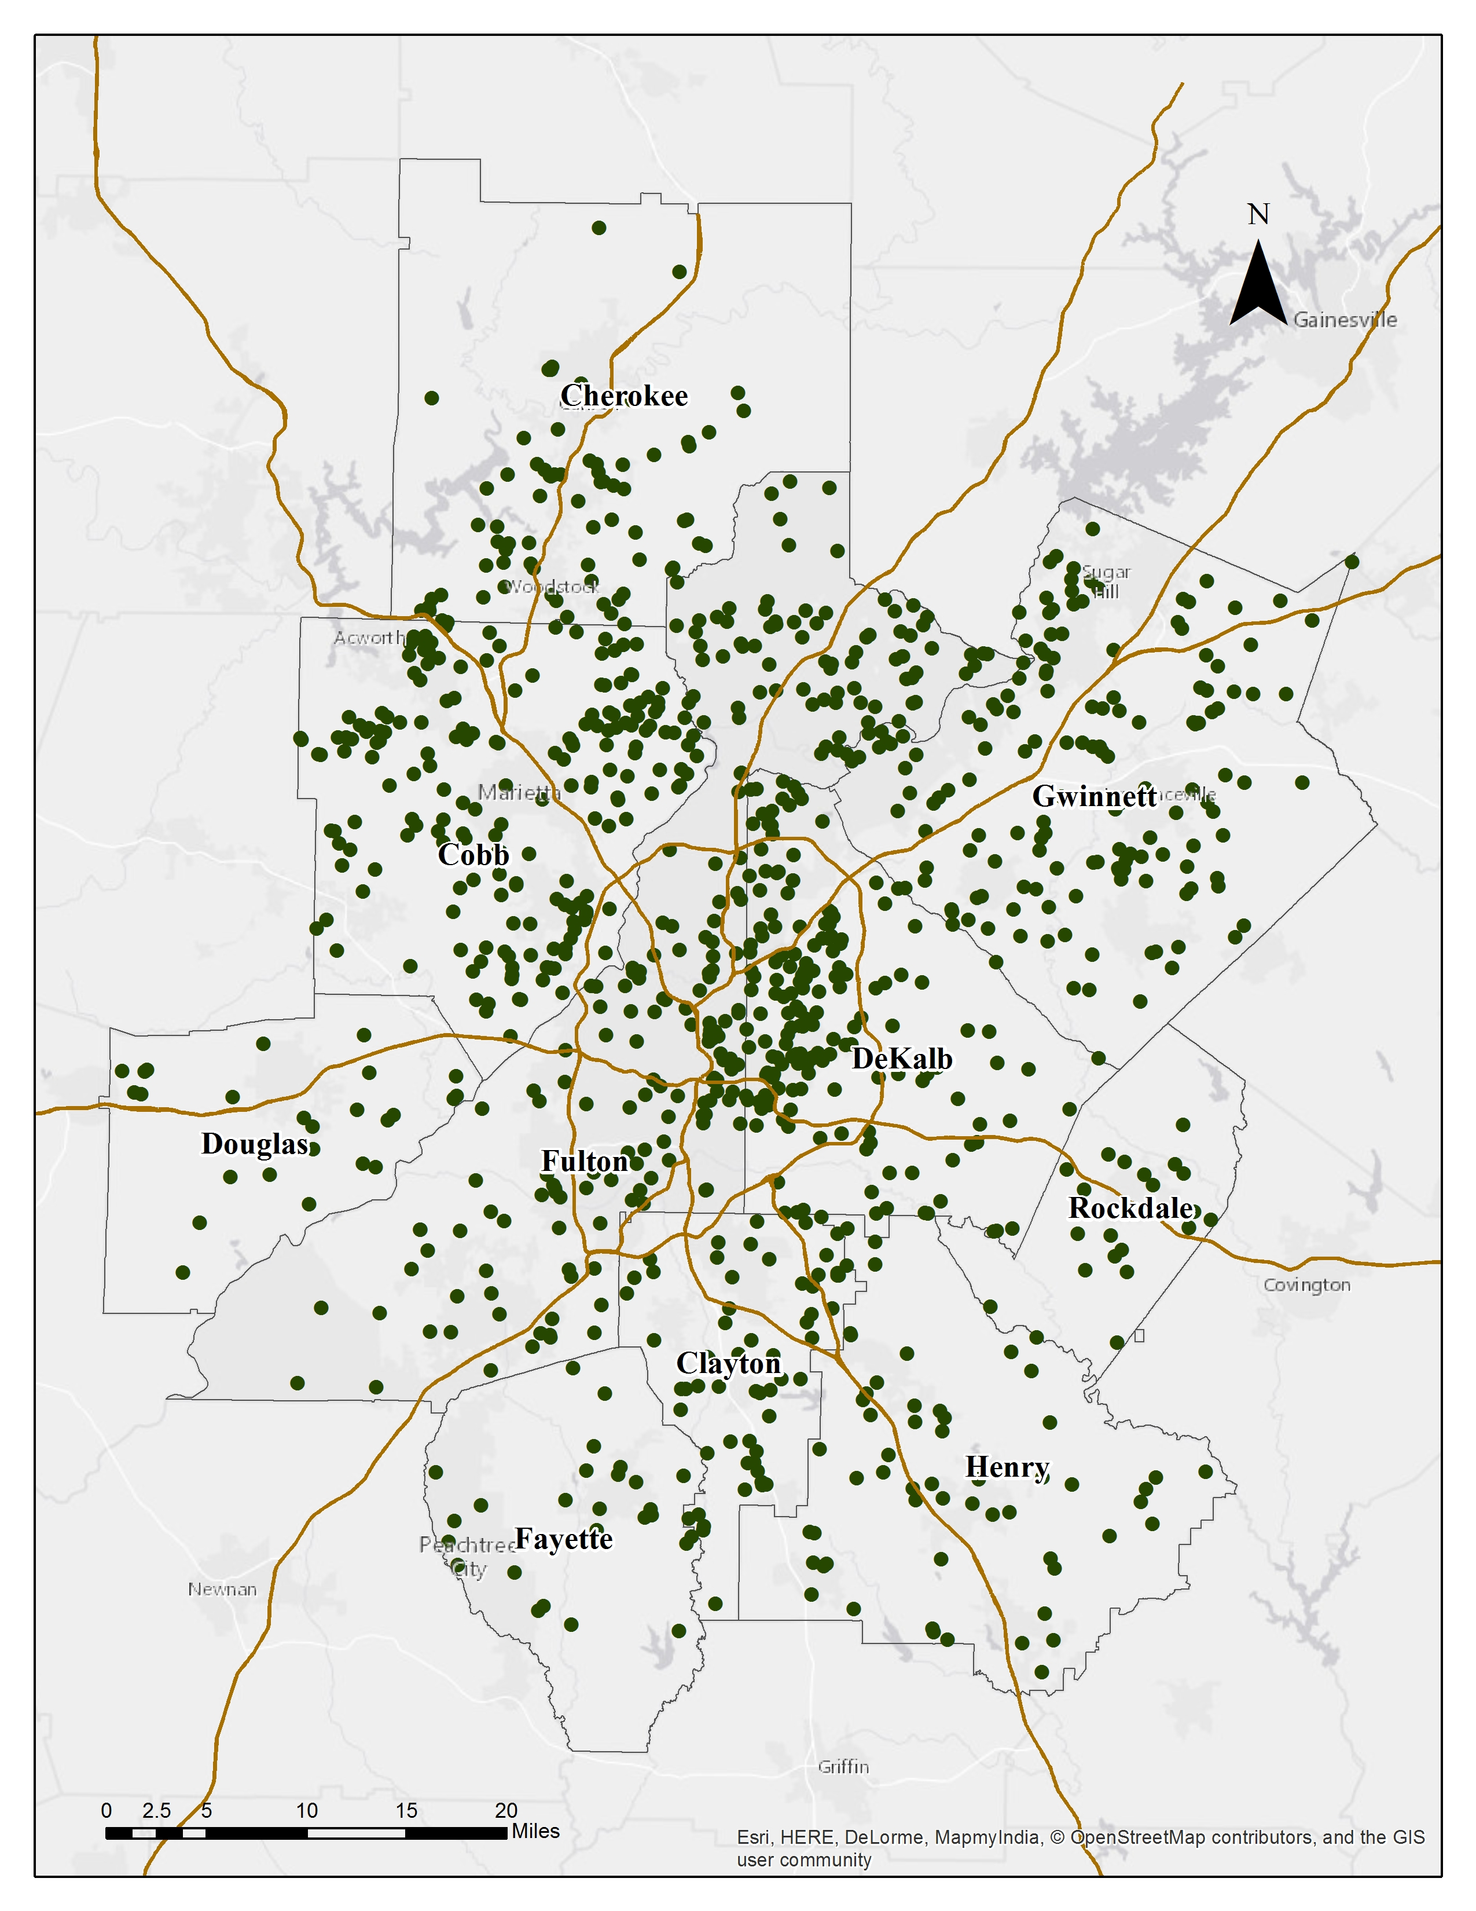
Residential Location Choice Model Data Sources
1
Data Filter
Purchased property within 5 years
Households with workers [no telecommute]
Removed outliers [price, built year…]
Removed records with missing values
Final Households #: 909

Slide 10
Residential Location Choice Model Alternatives Development
1
“Alternatives” the set of properties on market for home buyer to choose from
Randomly Draw 29 Alternatives
Alt 1
Alt 2
Alt 3
Alt 4
……
Alt n-1
Alt n
Oct
2008
Nov
2008
Dec
2008
Feb
2009
Aug
2009
Sept
2009
Time
Mar
2009
Oct 2008
Sept 2009
6 month
6 month
One-year Moving Time Window

Slide 11
Residential Location Choice Model Independent Variables
1
Household characteristics
Household size
Income
Race/Ethnicity
Vehicle ownership
Age
Property characteristics
Sale price
Bedroom + Bathrooms
Sizes (Finished/Lot)
School Quality
Property type (single family, condo)
Built Environment
Entropy Index
Density
Park Accessibility
Walkscore
Transportation Costs
Commute time cost
Commute time * hourly salary
Vehicle cost
Mile based cost * commute distance
Notes:
Replace variables with diagrams

Slide 12
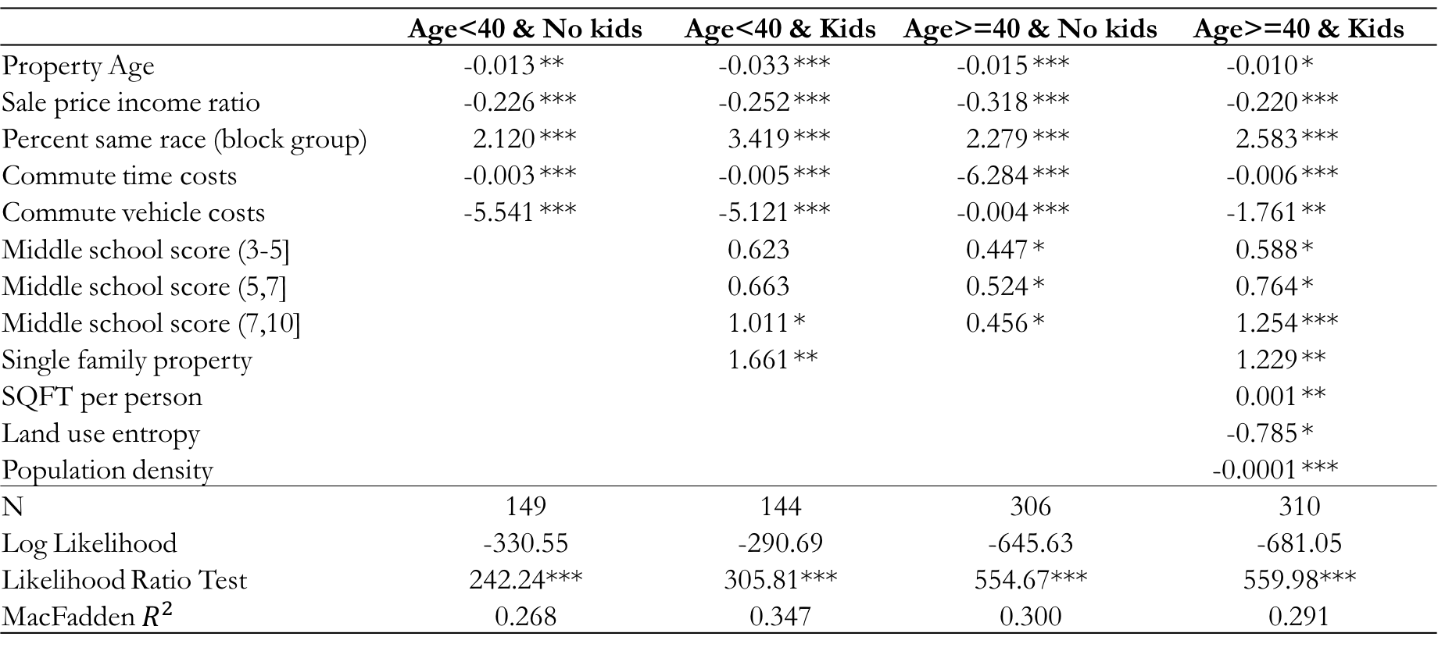
Residential Location Choice Model Model Results by Market Segments
1
 | Age<40 & No kids |  | Age<40 & Kids |  | Age>=40 & No kids |  | Age>=40 & Kids
Property Age | -0.013 | ** | -0.033 | *** | -0.015 | *** | -0.010 | *
Sale price income ratio | -0.226 | *** | -0.252 | *** | -0.318 | *** | -0.220 | ***
Percent same race (block group) | 2.120 | *** | 3.419 | *** | 2.279 | *** | 2.583 | ***
Commute time costs | -0.003 | *** | -0.005 | *** | -6.284 | *** | -0.006 | ***
Commute vehicle costs | -5.541 | *** | -5.121 | *** | -0.004 | *** | -1.761 | **
Middle school score (3-5] |  |  | 0.623 |  | 0.447 | * | 0.588 | *
Middle school score (5,7] |  |  | 0.663 |  | 0.524 | * | 0.764 | *
Middle school score (7,10] |  |  | 1.011 | * | 0.456 | * | 1.254 | ***
Single family property |  |  | 1.661 | ** |  |  | 1.229 | **
SQFT per person |  |  |  |  |  |  | 0.001 | **
Land use entropy |  |  |  |  |  |  | -0.785 | *
Population density |  |  |  |  |  |  | -0.0001 | ***
N | 149 |  | 144 |  | 306 |  | 310
Log Likelihood | -330.55 |  | -290.69 |  | -645.63 |  | -681.05
Likelihood Ratio Test | 242.24*** |  | 305.81*** |  | 554.67*** |  | 559.98***
MacFadden $R^{2}$ | 0.268 |  | 0.347 |  | 0.300 |  | 0.291

Slide 13
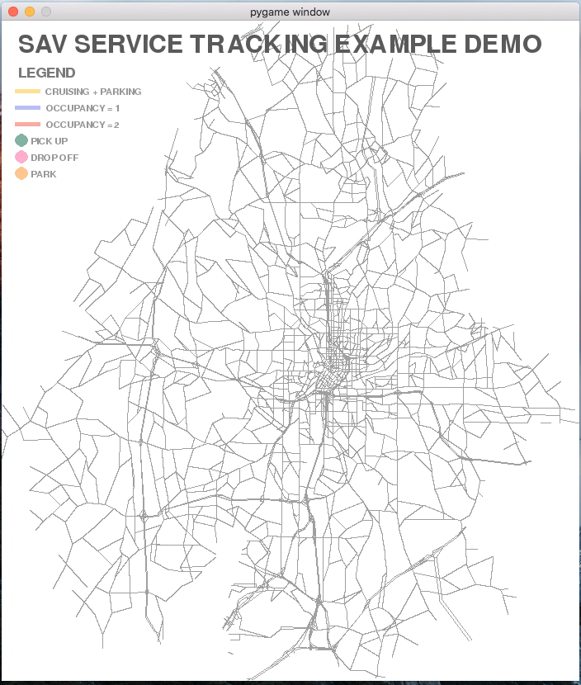




SAV Simulation Model Conceptual Model
2
Transportation Network
7:05 am
Willing to share
Relocate to underserved area
@7:15 am
Minimize parking cost
7:15 am
Willing to share
Assign the SAV with least expected delay time
Notes:
So we moved on to develop this ride-sharing model.

Slide 14
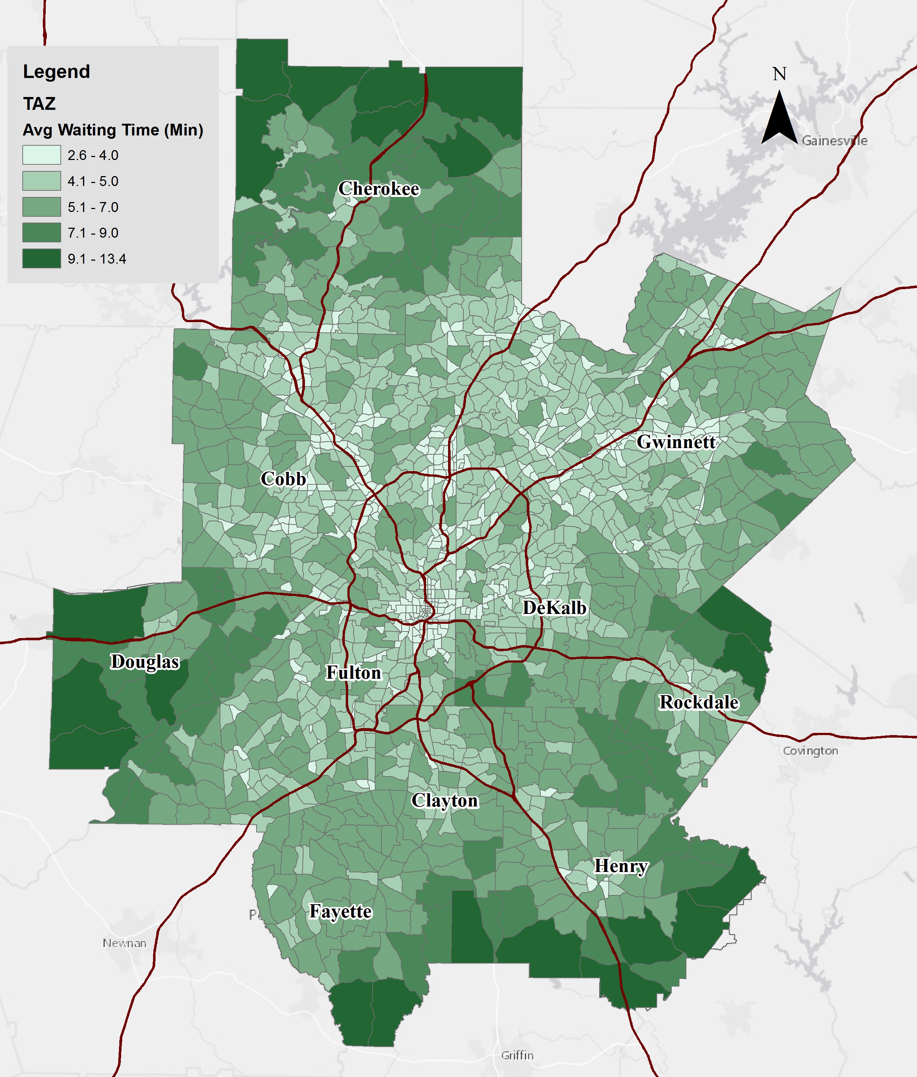
SAV Simulation Model Transportation Costs Updates
2
Travel Time Costs
= Waiting time * Hourly salary
Vehicle Costs
= 0 ownership cost +
SAV per mile based cost * Commute Distance
SAV cost per mile studies
¢15-41/mile [Burns et al., (2013)]
¢29/mile [Barclay (2016)]
¢31-46/mile [ Deloitte (2016)]
¢17/mile [KPMG (2016)]
¢13-¢50/mile: ¢15, ¢30, ¢ 50/mile

Slide 15
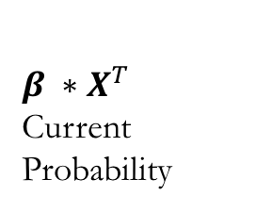

Residential Location Choice Model Update Monte Carlo Simulation
3
Alt 1
Alt 2
Alt 3, current Choice
Alt 4
Alt 29
Alt 30
…...
$$β ∗X^{T}$$
Current Probability
0.02
0.13
0.21
0.07
0.06
0.15
$$β ∗X_{SAV}^{T}$$
New Probability
0.13
0.25
0.09
0.03
0.07
0.01
0.13
0.25
0.09
0.03
0.07
0.01
0
0.13
0.38
0.47
0.51
0.99
1
Random Number = 0.073
Randomly Draw for 1000 times to determine the DISTRIBUTION of choice

Slide 16
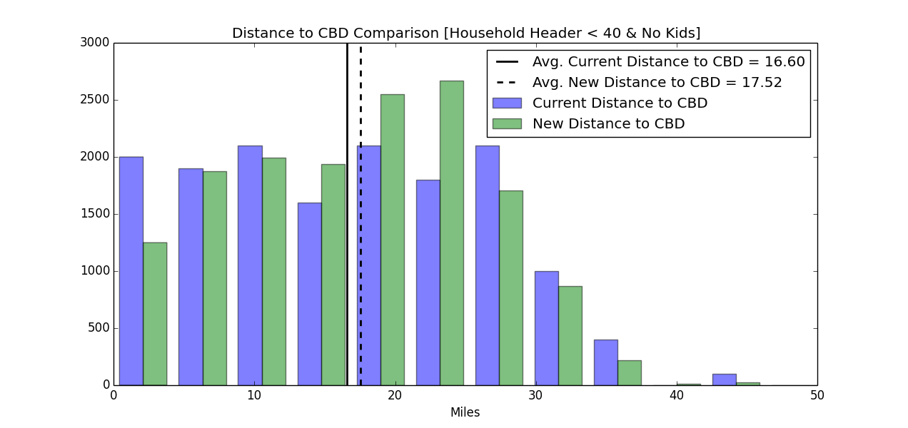
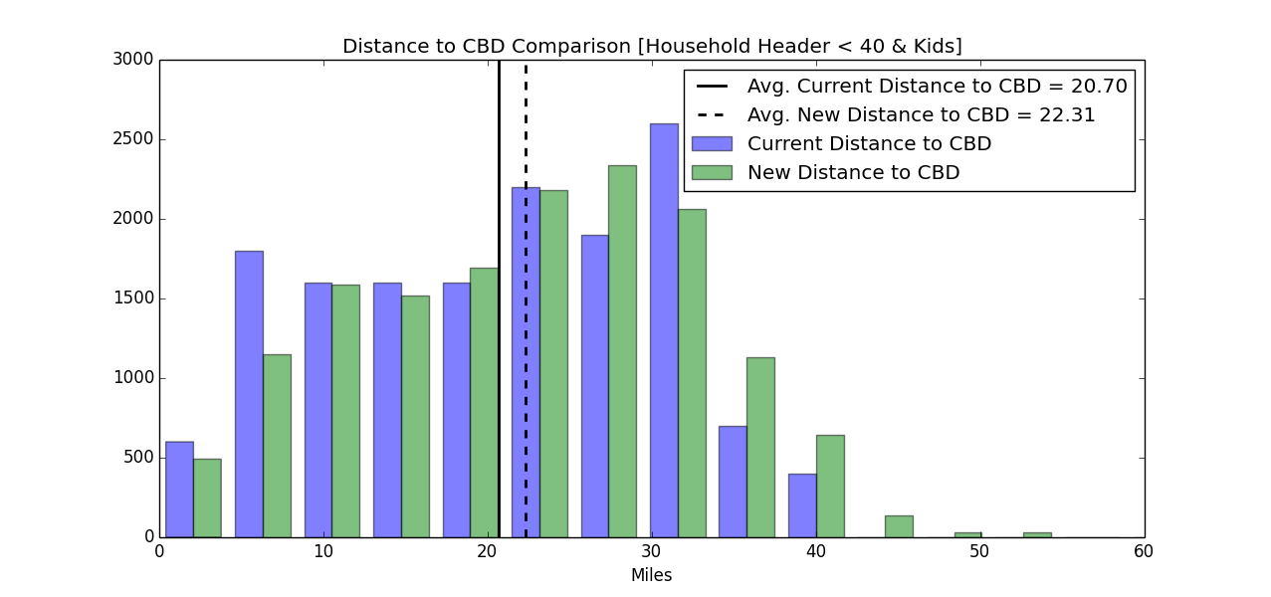
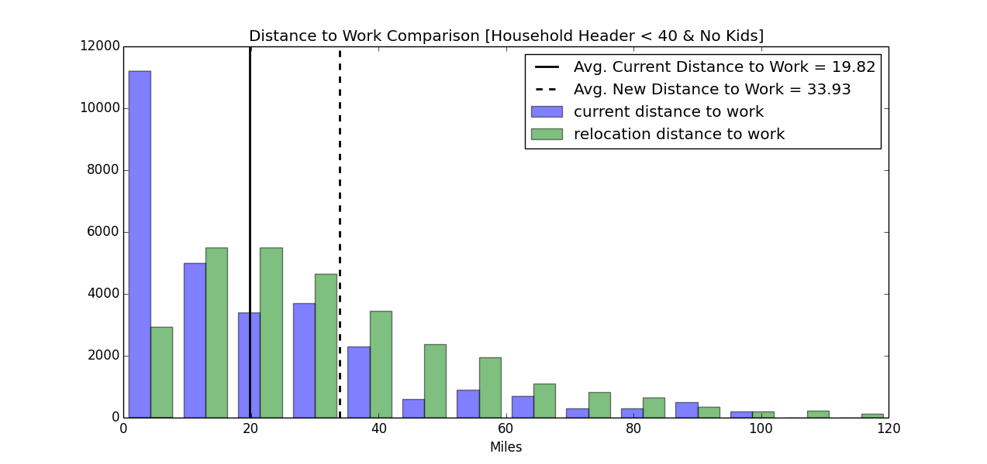
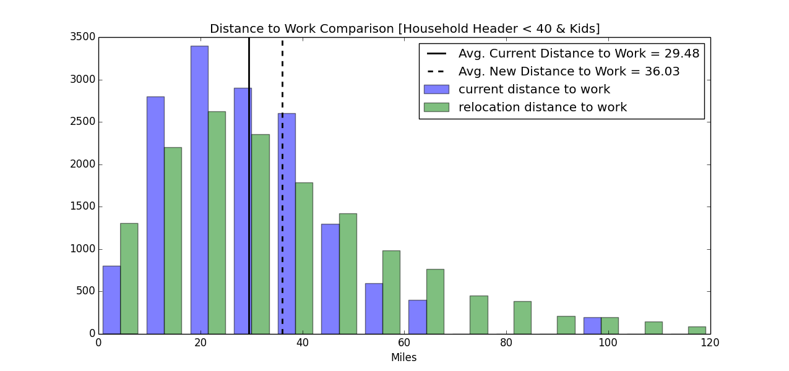
Residential Location Choice Model Update New Residential Location Choices (¢30cents/mile)
3
HH < 40 & No Kids
HH < 40 & Kids
One tail t-test: -3.969 ***
One tail t-test: -13.705 ***
One tail t-test: -69.789 ***
One tail t-test: -27.050 ***

Slide 17
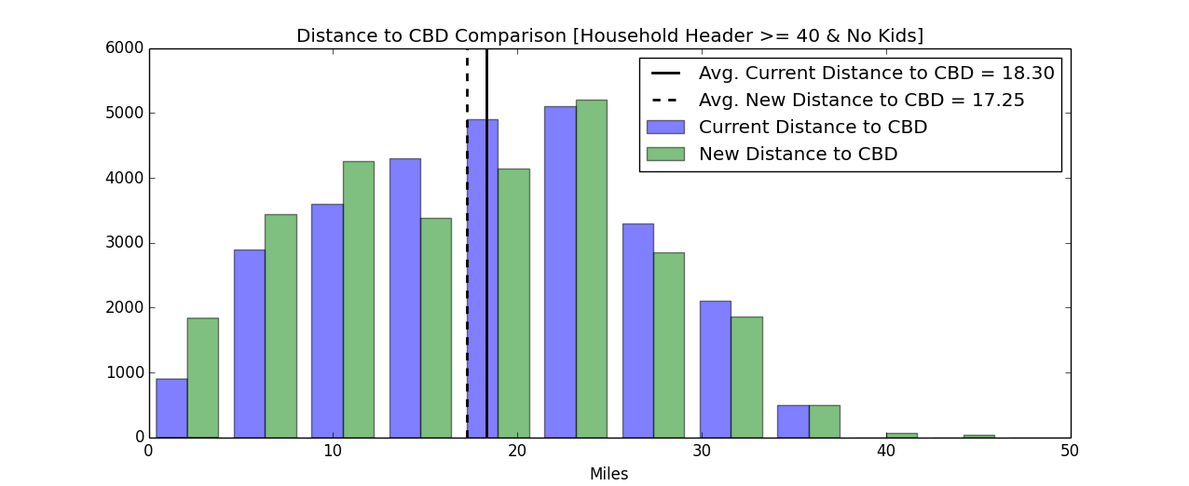
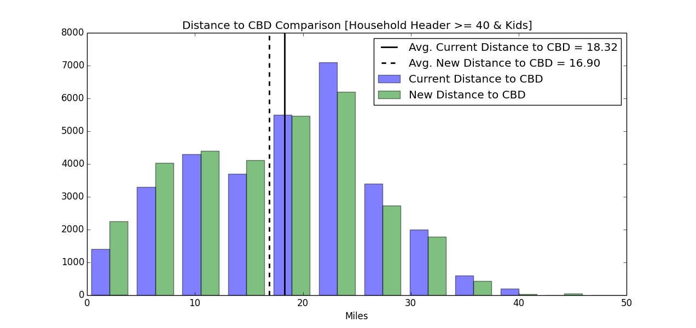
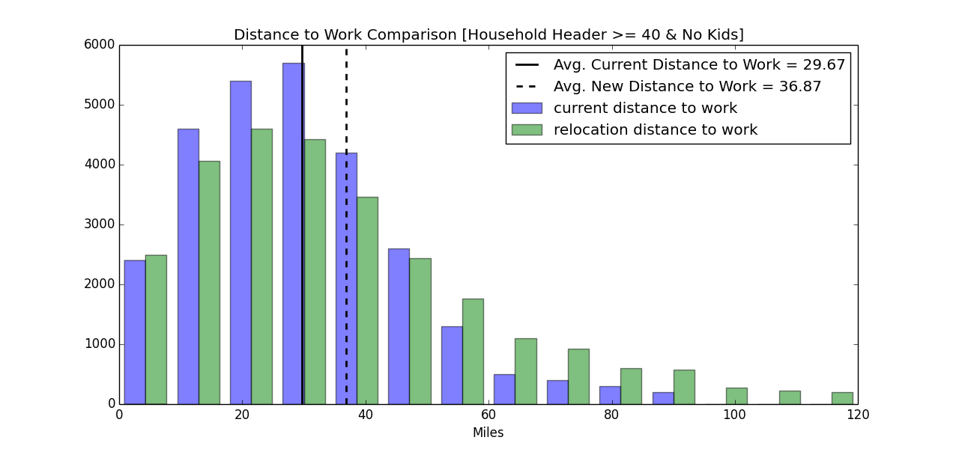
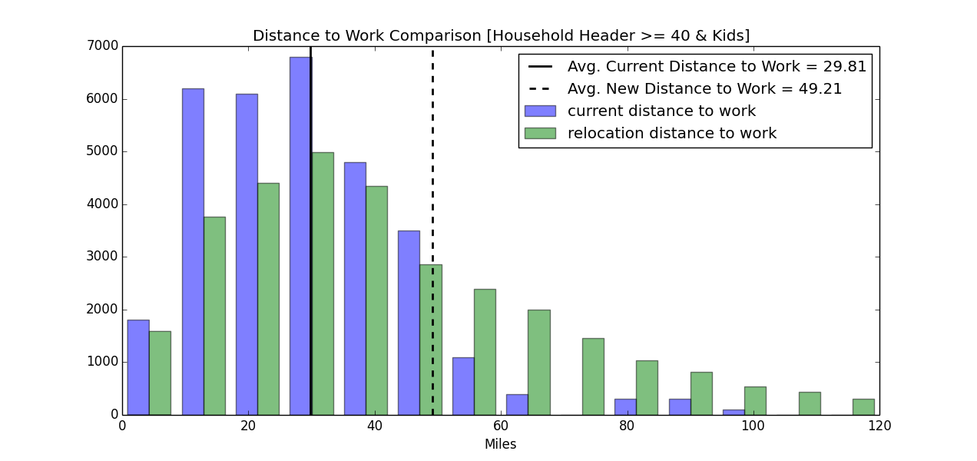
Residential Location Choice Model Update New Residential Location Choices (¢30cents/mile)
3
HH >= 40 & No Kids
HH >= 40 & Kids
One tail t-test: 14.947***
One tail t-test: 20.075***
One tail t-test: -38.201***
One tail t-test: -27.225***

Slide 18
Discussions and Conclusions
Model Outputs
Workers will move away from working places
Households with different age tend to move in different directions with respect to CBD
Model Limitations
SAVs is the only modeled travel mode, shift in modes is not considered
Assumed preferences doesn’t change overtime
Future work
Scenario development: changing the coefficients in the residential location choice model
Destination choices for other trip purposes; Choice of other modes

Slide 19
Thank You
Questions & Comments

